Slide 1

APPLICATION TO POSTSECONDARY

Slide 2
TOPICS COVERED
APPLICATION SYSTEMS
APPLICATION PROCESS
APPLICATION TIMELINE
APPLICATIONS – HOW-TO
CAREER EXPLORATION - MAKING AN INFORMED CHOICE
Q&A

Slide 3
HIGH SCHOOL DIPLOMA REQUIREMENTS

Slide 4
TO OBTAIN YOUR DIPLOMA, YOU NEED:
TOTAL CREDITS NEEDED:
TOTAL SEC. 5 CREDITS:
THESE ARE THE MINIMUM REQUIREMENTS. CEGEPS ARE LOOKING FOR STUDENTS WHO HAVE A COMPETITIVE PROFILE.
SECONDARY 4
54
MATH
SCIENCE
HISTORY
ART
20
SECONDARY 5
ENGLISH
FRENCH
ERC OR PHYS. ED.

Slide 5
QUEBEC EDUCATION SYSTEM

Slide 6
QUEBEC EDUCATION SYSTEM

Slide 7
CEGEP PROGRAMS

Slide 8
PRE-UNIVERSITY
TECHNOLOGY
2 years
Prepares students for higher education
Theoretical rather than hands-on
Limited practical value IF the student doesn’t attend university
Further study required to develop skills and competencies to obtain a career in that field
3 years
Prepares students for the world of work
Develop marketable knowledge and skills
Often include internships and hands-on training
Graduates can go on to university
May need to make up courses
May get advanced standing

Slide 9
PREPARATORY PROGRAMS
1 or 2 semesters long
For students missing prerequisites and who have NEVER TAKEN them before (Pre-requisites)
Math SN5, Physics, Chemistry
Environmental Science Sec. 4 is the prerequisite for Chemistry and Physics
When applying, must specify a target program
For students unsure of what they would like to study, or who need additional support academically
Varies by school

Slide 10
APPLYING TO CEGEP

Slide 11
APPLICATION SYSTEMS

Slide 12





Slide 13

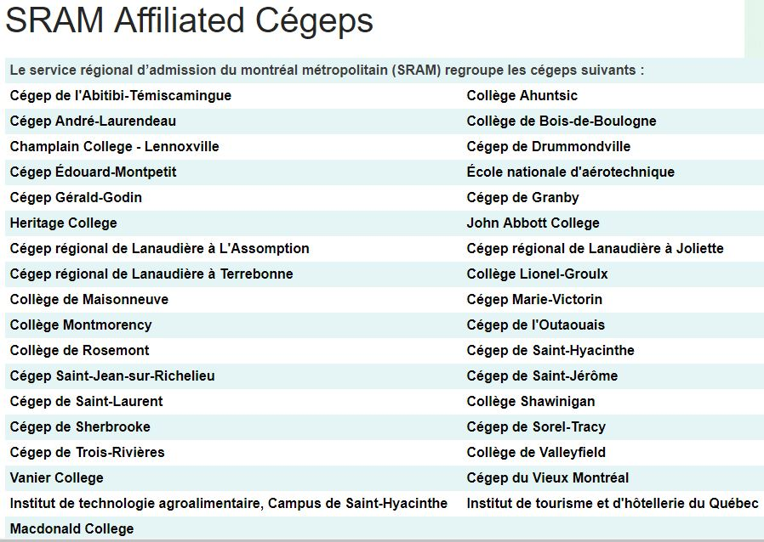



Service régional d’admission du Montréal métropolitain
Kiuna

Slide 14






INDEPENDENT APPLICATION SYSTEMS

Slide 15
APPLICATION PROCESS

Slide 16

SRAM – CEGEP APPLICATION PROCESS

Slide 17
APPLICATION PROCESS
Choose program(s) and school(s)
1
Check whether you qualify for the program
2
Prepare supporting documents
3
Complete online application form
4
Make payment
5
Check status of application
6

Slide 18
APPLICATION TIMELINE

Slide 19
CEGEP APPLICATION PROCESS
MAY-JULY
Explore programs, attend fall open houses
Applications open
Attend Winter Information Evenings
Applications due
Hear back from schools, make further choices
Continuing Education applications open
APRIL-MAY
MARCH 1
FEBRUARY
MID-JAN
FALL

Slide 20
ADMISSIONS

Slide 21
GENERAL ADMISSION Factors
Competitive overall average
Number of credits accumulated
Good marks compared to class average
Courses with more credits attached are worth more
Higher quintile rank (Rating out of 5)
1 = performing in the top 20% of your class
5 = performing in the bottom 20% of your class
Must be in graduating position

Slide 22
PROGRAM-SPECIFIC REQUIREMENTS
For Science programs
Enriched Math, Chem., etc.
For Tech. programs, especially Medical or Social techonologies
Letter of Intent
Interview
For Performing Arts programs
Audition
For Paramedic and Police Technology
Driver’s License
Physical Testing
For Arts programs
Portfolio

Slide 23


Slide 24

Round System - SRAM
IMPORTANT DATES
January 13 , 2026 | Applications for admissions are open on admission.sram.qc.ca
March 1, 2026, 11:59pm | Deadline for applications to Round 1
March 26, 2026 | Places available in Round 2 are listed on admission.sram and on SRAM's website
April 3, 2026 | Round 1 admission answers available on admission.sram.qc.ca
April 22, 2026, 11:59pm | Deadline for applications to Round 2
April 30, 2026 | Places available in Round 3 are listed on admission.sram.qc.ca and on SRAM's website
May 12, 2026 | Round 2 admission answers available on admission.sram.qc.ca
May 27, 2026, 11:59pm | Deadline for applications to Round 3
June 13, 2026 | Round 3 admission answers available on admission.sram.qc.ca
R1
R2
R3

Slide 25
Independent Application Systems
Birth Certificate required
Results sent electronically to the following:
Dawson College
Champlain College
Marianopolis College
Check with school if results need to be sent
Rounds vary by school – consult school website

Slide 26

Application Run-Through
https://admission.sram.qc.ca/

Slide 27
ROLES & responsibilities

Slide 28
Application Systems
Provides information and application assistance to applicants.
Receives the admission application from each applicant
Verifies that files are complete.
Produces ranking lists based on criteria established by the schools for greater equity
Transmits application files to relevant school

Slide 29
Applicant
Be knowledgeable about the application procedures and requirements and respect all admissions conditions
Assume entire responsibility in sending valid and legible copies of all requested documents to the application system, before the deadline
Provide accurate and truthful information in their application
Keep track of the status of their application online.In the event that sent documents are not accepted (not received or inadequate), verify the source of the problem and correct the situation before the deadline.
Completing the payment, also before the deadline.
Follow up on their application to make sure it is complete and all documents have been received.

Slide 30
Applicant [After a verdict is reached]
Must check their online file on to know the school's answer to their application.
If admitted, applicants must read the letter sent from the college either physically or electronically and carefully follow the registration process.
If refused, applicants to SRAM should return to their online file and submit a new choice if they wish to participate in the next round.
If refused, applicants to other application systems must choose a backup plan

Slide 31
APPLYING TO FRENCH CEGEPS

Slide 32



FRENCH CEGEPS
Most French CEGEPs are on SRAM system
Often have more space, options easier to get to
Often require a French placement test when applying from an English school – make sure to check before applying

Slide 33
APPLICATION STRATEGY

Slide 34
Application Strategy
Apply to multiple colleges (a minimum of 2 is recommended).
Only apply to programs that you are currently qualified for (students should meet with their guidance counsellor for more information).
Some of the college institutions (SRAM colleges, Dawson, etc.) will allow you to make a second choice if you are refused from your first choice of program.
It is important to look at which programs still have spaces available, and the deadline to submit your choice

Slide 35
AFTER MAKING YOUR APPLICATION
Print your transmission receipt/proof of application
Take note of your applicant number
Login to the application system to verify the status of your application
Check that it is marked “complete,” because if it is not, your application will not be considered

Slide 36
Admission decisions

Slide 37

IF YOU ARE... ADMITTED
Conditional Acceptance
You are accepted on the condition that:
you obtain your Diplôme d’études secondaires (D.E.S.)
You obtain the pre-requisite(s) required for your program
You maintain the marks you earned in Terms 1 and 2
Confirm your attendance, even if you are waiting for an answer from another college
Take note of the confirmation deadline, make a decision, and notify the colleges A.S.A.P.
If you are still confirmed at 2 or more colleges past the deadline, your application will be revoked
If needed, financial aid is available. Speak to your Guidance Counsellor or the College’s Financial Aid Officer

Slide 38

If you are admitted:
Please
Please
Please

Slide 39

IF YOU ARE ADMITTED
Reserve your place by paying the 1st semester fee
You may be asked to write an English or French Language placement test
Get Informed! Read all new student information posted on your college website
Look for documents under “Future Students”
Attend your Orientation Session (May)
Get information on your chosen program, registration for courses, and get a tour of the campus

Slide 40

REFUSED
Verify the reason for refusal
Consider other programs that may still be available
SRAM Round 2; Dawson, Private Colleges
Consult the Admissions Department
Make a Plan with the Guidance Counsellor
Cont. Ed., Adult Ed., etc.

Slide 41

Other PLANS

Slide 42
Continuing Education
Continuing Education operates separately from a school's regular day programs
Students attend classes at night and on weekends (up to 4 per semester, compared to 7 on average during the day)
Various types of programs offered:
Credit courses: Classes that count as prerequistes OR count towards an eventual DEC
AEC: training certificates on a specific area (must be 1 year out of high school)
Applications typically open AFTER you hear back from day programs
May make decisions based on FINAL results (rather than Term 1)

Slide 43

Adult Education is a way of
Completing high school graduation requirements
Taking missing pre-requisites while not enrolled in CEGEP
Courses can be taken online or in-person, with a flexible schedule
Closest English Center is CDC Vimont

Slide 44
APPLYING TO VOCATIONAL TRAINING

Slide 45
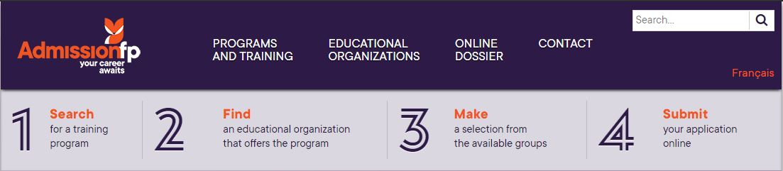

Slide 46
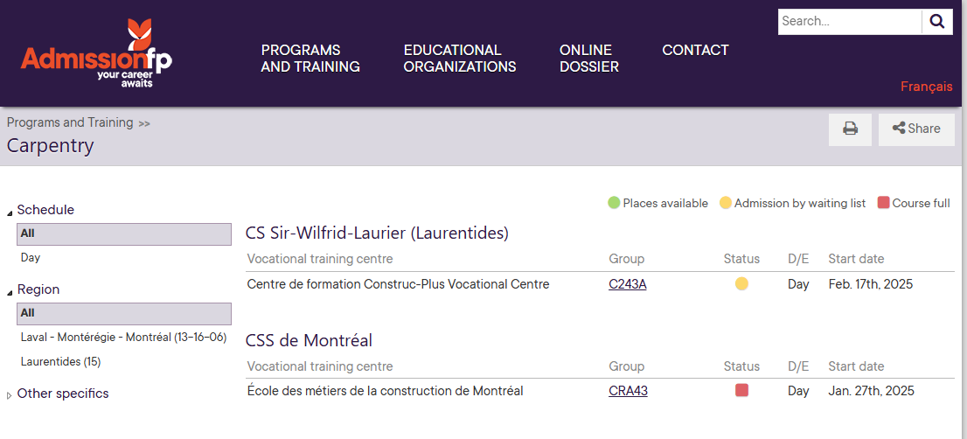
APPLICATION TIMELINE – VOC ED
Ongoing throughout the year – Start early and be aware of waitlists
Start dates do not follow "school year" format – pay attention to your start date!

Slide 47
CAREER EXPLORATION

Slide 48
Research Methods
Open Houses
Student-for-a-Day
College Viewbooks
Career Exploration Process with your Counsellor
Assess your Interests, Personality and Values using a validated measure that is used widely in the field of career counselling in Quebec
Be matched with corresponding careers listed on Emploi-Québec
Learn to use labour market information to make informed choices
Develop a plan to further explore and narrow down your options

Slide 49

Money For School
Government | Aide financier aux etudes – AFE Needs-based Bursary and loan portions
School | Entrance and exit awards Merit-based
External | Affiliation, need, or merit-based Corporations, foundations, community organizations, etc…

Slide 50
Winter Information Evenings
College | Session Date
John Abbott | Wednesday, January 28, 2026 from 6:00-8:30 pm
Cégep de Lanaudière à Terrebonne | Thursday, February 12, 2026 from 5:30-8:30 pm
Vanier College | Tuesday, February 3, 2026 from 5:30-8:30 pm
Dawson College | Wednesday, February 4, 2026 from 4:00-8:00 pm
Cégep de Saint-Jérôme | Wednesday, February 11, 2026 from 5:00-8:00 pm
Collège Lionel-Groulx | Wednesday, February 4, 2026 from 5:00-8:00 pm
Champlain St-Lambert | Thursday, February 5, 2026 from 6:30-8:30 pm
Marianopolis | Wednesday, February 5th, 2025 from 6:00-8:30 pm
Collège Montmorency | Tuesday, February 3, 2026 from 6:00–9:00 pm

Slide 51

Research and Refine Your Options

Slide 52

Research and Refine Your Options

Slide 53
Q&A
Ask us anything!

Slide 54
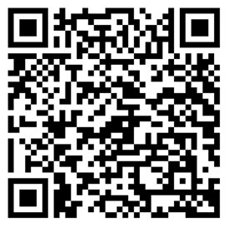
BOOK AN APPOINTMENT WITH YOUR GUIDANCE COUNSELLOR

